Slide 1

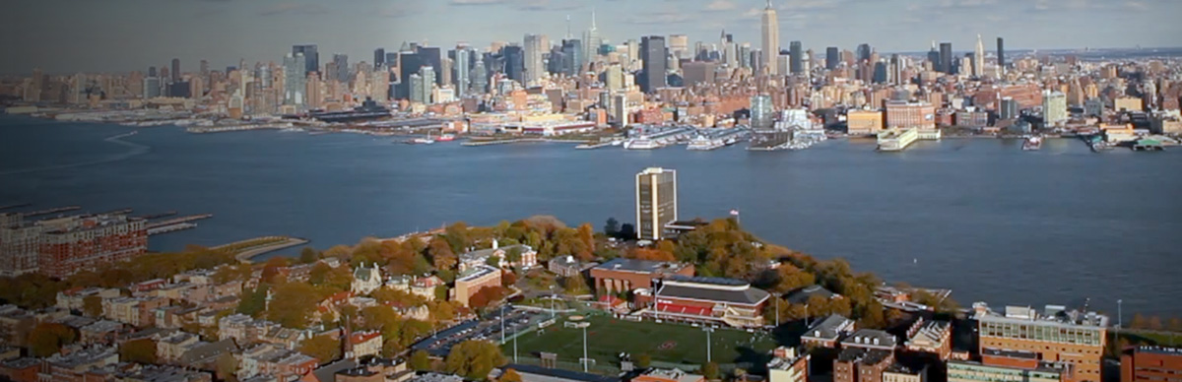
Big Data Technology – BIA 678
David Belanger PhD
Senior Research Fellow – Stevens Institute of Technology
dbelange@stevens.edu
“The Best Data is More Data”
Source: Unknown, thought to be from NLP community (Banko?, Brill?).

Slide 2
How Should I Think About Big Data? Picture from GitHub [https://github.com/hadoop-illuminated/hadoop-book]

Slide 3
Course Information
Course Materials:
There will be a variety of readings for each class.
There is available a training set on Hadoop from Cloudera.
!!Hadoop Bootcamp Feb 23, March 2. Jimmy Zhang ++
Office Hours: Officially Tuesday 2 – 4,
Typically around Monday PM, until Wednesday AM.
Or By Appointment
Office: Currently Babbio 303
Grading Assistant:– LuLu Zhu - On Canvas
Systems Plan:
Cloudera on all Laptops
Access to a Cluster/Cloud for Projects (later in semester)
Cluster will contain, at least: Hadoop, Cassandra, Rhadoop, Spark.
Many people will end up using Python and Spark for team project.

Slide 4
Course Information
Grades:
Team Project (Written & Oral). (40%)
Milestones Throughout the Semester (TBA).
Oral Presentations for each team in last class (or if necessary last 2 classes).
Teams can be 1 – 4 people.
A short, ½ page, proposal will be due at Class 6. Proposed data and goals.
Students will form their teams, but team membership should be decided by Class 3. In some cases minor changes can occur later. Fill out the equivalent of slide 9 for your team by class 3. If changes, submit new slides.
Class Leadership and Homework. (25%)
In each class meeting, members of the class will be assigned readings on which they will lead discussion. Everyone should read all readings and be prepared to discuss them. Students will be randomly selected to report on readings.
Each student will write and sbmit a short review of readings, about ½ page, each week.
About every 2 weeks, programming homework assignments will be given.
Term Papers. (35%)
One term paper, of about 5 – 8 pages, on a subject of the student’s choice.
Paper due last week of October (Class 9), Penalties if Later.
Proposed topic, with short abstract, is due in Class 3.
Late Policy: For reading reports, papers later than the end of the week due will be penalized 50%.

Slide 5
Course Information
Career Fair – November.
Each November there is a BIA Career Fair.
You should consider submitting your project to the Career Fair. It will mean finishing a poster for the project a week or two early, but is well worth it for meeting corporate folks.
In any case, you should consider making your project suitable for placement on your web site.

Slide 6
Team Pictures Teams 1 – 4 Folks (A picture of you, and your name; Optional: Your Major, Home City)
DGB Williams F1 Oxford UK
DGB Chief Scientist
DGB Emmy Las Vegas
Daughter’s Wedding Reception
DGB WWW2008 Keynote, Beijing

Slide 7
KDNuggets A Good List of Free Data Sources and A Good Source for Interesting Data Science Information
https://www.kdnuggets.com/2017/12/big-data-free-sources.html
Kaggle is also often a source of very good data.

Slide 8
Readings Due Class 2: Introduction
Readings | Discussion Leaders
Lin & Ryaboy, “Scaling Big Data Mining Infrastructure: The Twitter Experience”, SIGKDD Explorations, V14 I2 http://www.kdd.org/sites/default/files/issues/14-2-2012-12/V14-02-02-Lin.pdf http://kdd.org/exploration_files/V14-02-02-Lin.pdf
McKinsey Global Institute, “Big Data: The next frontier for innovation, competition, and productivity”, 2011 http://www.mckinsey.com/Search.aspx?q=big%20data%20the%20next%20frontier%20for%20innovation%20competition%20and%20productivity&l=Insights%20%26%20Publications
BIG – Big Data Technical Working Groups White Paper 5/2014 http://big-project.eu/sites/default/files/BIG_D2_2_2.pdf

Slide 9
Sources Due Class 3: Scale
Readings | Discussion Leaders
Dean & Ghemawat, “MapReduce:Simplified Data Processing on Large Clusters”, http://static.googleusercontent.com/media/research.google.com/en/us/archive/mapreduce-osdi04.pdf, 2004
Ghemawat, et al, “Google File System”, http://static.googleusercontent.com/media/research.google.com/en/us/archive/gfs-sosp2003.pdf , 2003
Notes:
Apache MapReduce Tutorial, https://hadoop.apache.org/docs/r1.2.1/mapred_tutorial.html

Slide 10
Project Grading
Grades based on (range 0 – 5, average 3):
Presentation & Paper:
Topic
Knowledge
Depth
Clarity
Content
Conclusion
Plagiarism will result in very severe penalties
CAL will provide detailed instructions on writing papers.
https://owl.english.purdue.edu/owl/resource/658/1/

Slide 11
Class Structure
In general, the structure of each class will be:
Discussion of assigned readings
Students randomly selected to report on readings
Lecture
Technology Discussion (i.e. tools)
Project Discussion

Slide 12
Ethics Statement “Turn it in” will likely be used to check term papers and team reports for plagerism!!
The following statement is printed in the Stevens Graduate Catalog and applies to all students taking Stevens courses, on and off campus.
“Academic Improprieties
The term academic impropriety is meant to include, but is not limited to, cheating on homework, during in-class or take home examinations and plagiarism. The Institute has adopted a procedure to deal with such actions. An instructor of a graduate course may elect to formally charge a student with committing an academic impropriety to the Dean of Graduate Academics or to adjudicate the issue personally.”
Consequences of academic impropriety are severe, ranging from receiving an “F” in a course, to a warning from the Dean of the Graduate School, which becomes a part of the permanent student record, to expulsion.
Reference: https://www.stevens.edu/provost/graduate-academics/handbook/academic-standing.html#PDG

Slide 13
Ethics Pledge
Consistent with the above statements, all homework exercises, tests and exams that are designated as individual assignments MUST contain the following signed statement before they can be accepted for grading.
_____________________________________________________________________
I pledge on my honor that I have not given or received any unauthorized assistance on this assignment/examination. I further pledge that I have not copied any material from a book, article, the Internet or any other source except where I have expressly cited the source.
Signature _________________________ Date: _____________
Please note that assignments in this class may be submitted to www.turnitin.com, a web-based anti-plagiarism system, for an evaluation of their originality.
____________________________________________________

Slide 14
Some More Multivariate Datasets
Dataport.ieee
http://www.crcpress.com/product/isbn/9781439816806
http://statistics.ats.ucla.edu/stat/examples/pma5/default.htm
http://archive.ics.uci.edu/ml/datasets.html
http://kaggle.com
https://opendata.socrata.com/
http://data.gov/
http://hadoopilluminated.com/hadoop_illuminated/hadoop-illuminated.pdf Pages 64++
www.Kdnuggets.com
https://www.linkedin.com/pulse/ten-sources-free-big-data-internet-alan-brown

Slide 15
Goals of this Course
Content | Description | Notes
Management | BD is not only about technology, but about managing both organizations and technologies. | Though perhaps not as essential immediately, this is what you are being prepared to do sometime in your career.
Practice | Use of some of the more common tools available today in BD. E.g. Spark. | This should be useful in obtaining and succeeding in your first job.
Concepts | The basic concepts required to understand and practice BD | This is essential to understanding the current and future technology in BD
Theory | The mathematics, and algorithms supporting both CS and Analytic Technologies | We will do little at this level, in part due to the time available and breadth of the subject.

Slide 16
Course Topics
Modules | Purpose
Introduction | Overview of BD Technologies and Issues
Core Technologies for Distribution | Map/Reduce, Hadoop, HDFS, Spark – Dataframes, Compression
Data Base Management | CAP, NoSQL, Column Store, Hbase, Xquery, …
Data Stream Management | IoT, DSMS, Analytics on Streams
Big Data Analytics | Impact of Scale, Recommenders, Ensemble, Variety
Visualization | Effects of scale
Data Governance | Policy, Process, Practice
Meta Issues – Privacy, Security, Deployment, OA&M | GDPR, Verizon DBIR, Privacy Policies, Operations
Applications
Project Presentations

Slide 17
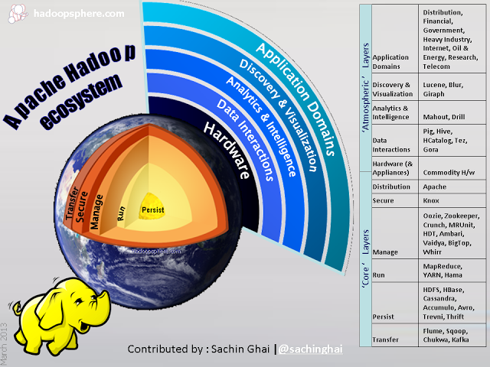
http://www.hadoopsphere.com/2013/03/apache-hadoop-ecosystem-march-2013_12.html

Slide 18
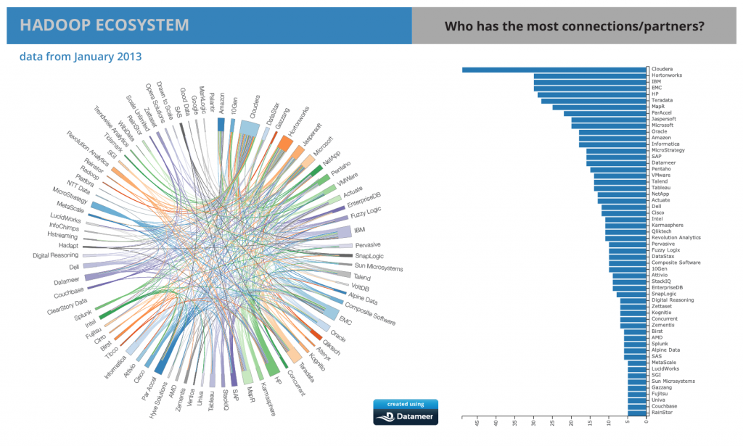
http://www.datameer.com/blog/perspectives/hadoop-ecosystem-as-of-january-2013-now-an-app.html

Slide 19
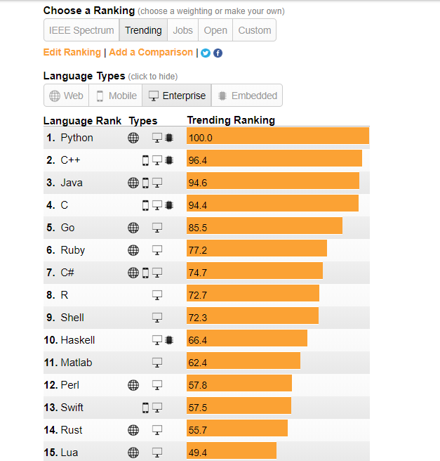
IEEE Spectrum Programming Language Ranking: Enterprise - Trending

Slide 20
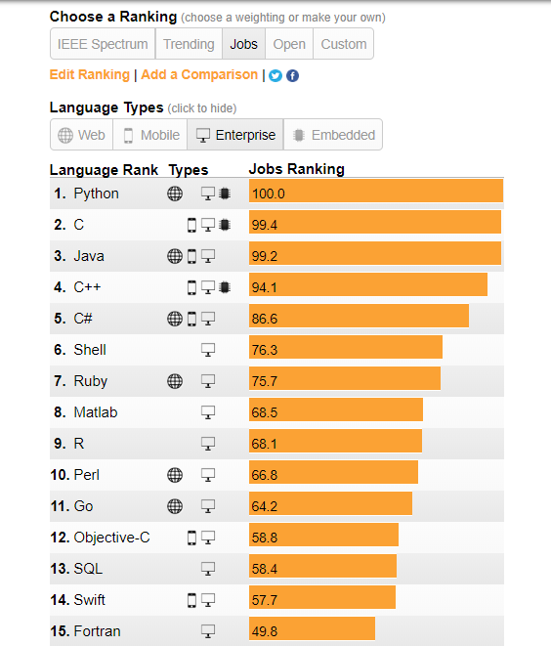
IEEE Spectrum Programming Language Ranking: Enterprise - Jobs

Slide 21
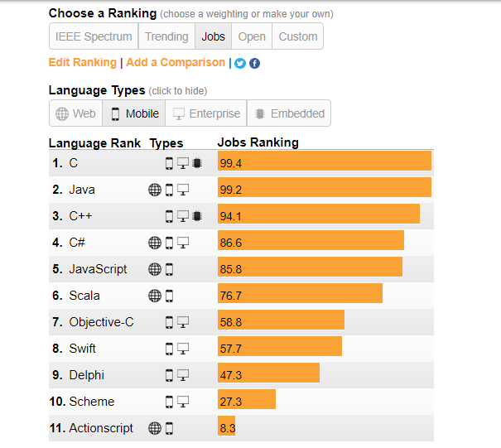
IEEE Spectrum Programming Language Ranking: Mobile - Jobs

Slide 22
The combination of Big Data and Mobility (Inconvenience Threshold and Half-Life of Information Value)
Inconvenience Threshold
Miles Feet Inches
Half-Life of Information Value
Wired Web Mobility IoT
Notes:
Some powerful trends that are impacting data - 1

Slide 23
Why should we care?

Slide 24
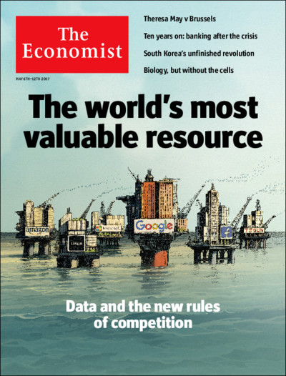

Slide 25
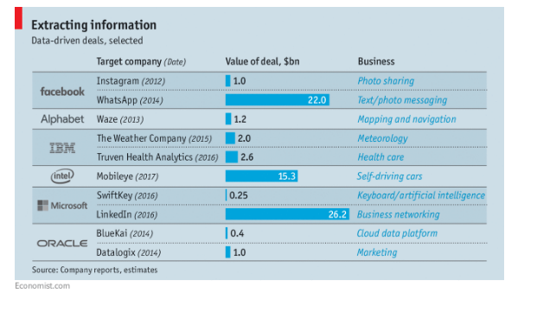

Slide 26
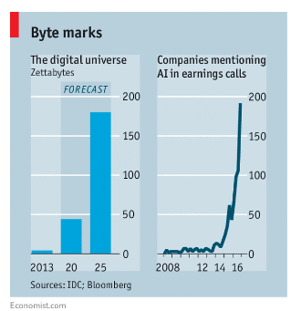

Slide 27
What’s Different? What! - Data

Slide 28
Some Things That Make a Difference Networking
Change | Classical | Big Data | Example
Latency | Transactional or Aggregate | Ranges to real time stream | Web Transaction vs Click Stream
Volume | Large | Larger | Web Logs
Collection | Transactional or Long | Often very distributed with collectors | Location
LAN | Many | IoT, Wifi/zigbe, many others. | Ad hoc for first responders
Fog/Edge | Rare | Increasingly necessary due to RT | Vessels at sea
Sources of Data | Operational, Organic | Operational + Crowd + Sensors + IoT + Manufactured
Data Integration @ Scale | Hard, Join, Structured | Structured & Unstructured, Large Scale, Still not easy
Streaming Data | Possible, using ad-hoc communication networking | Common, and with IoT to become much more common | IoT, High Freq Trading, Medical, etc.

Slide 29
Some Things That Make a Difference DATA
Change | Classical | Big Data | Example
Granularity | Transactional or Aggregate | Elementary, Personalized | Web Transaction vs Click Stream
Signal Strength | Strong | Σ Weak | Google Trends
Latency | Transactional or Long | Streams and Real time | Location
Location | ZIP Code, Area Code, Nxx, | GPS, Lat/Long | Location Based Systems
Structure | Relational | Structured, SemiStructured, Unstructured, Graph | Social Networks, Speech + Video Mining
Sources of Data | Operational, Organic | Operational + Crowd + Sensors + IoT + Manufactured | Dallas Museum of Art, Fitbit,
Data Integration @ Scale | Hard, Join, Structured | Structured & Unstructured, Large Scale, Still not easy
Streaming Data | Possible, using ad-hoc communication networking | Common, and with IoT to become much more common | IoT, High Freq Trading, Medical, etc.

Slide 30
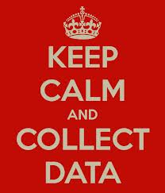

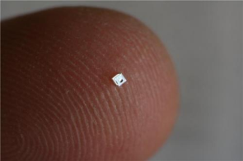
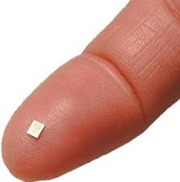
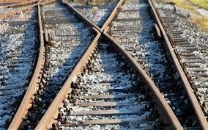

Data Analysis Lifecycle: IoT
Analyze
Decide
Control
Monitor
Instrument
Internet of Things
Big Data
Notes:
http://phys.org/news/2014-03-lifesaving-sensor-full-bladders.html
Rasberry Pi
Tee Shirt Label.

Slide 31
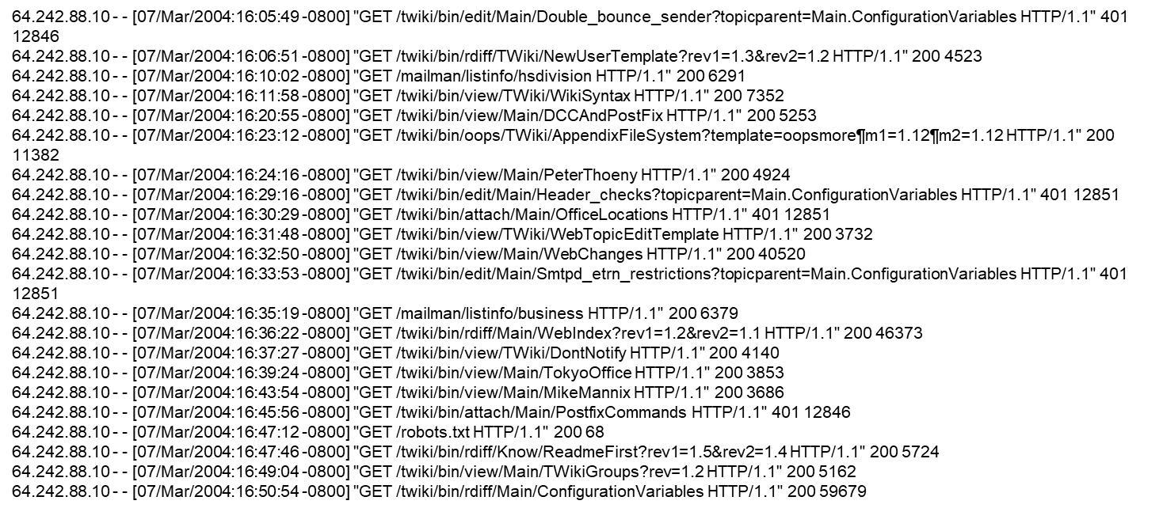
Example of Data
Apache Web-Log Data

Slide 32
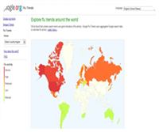
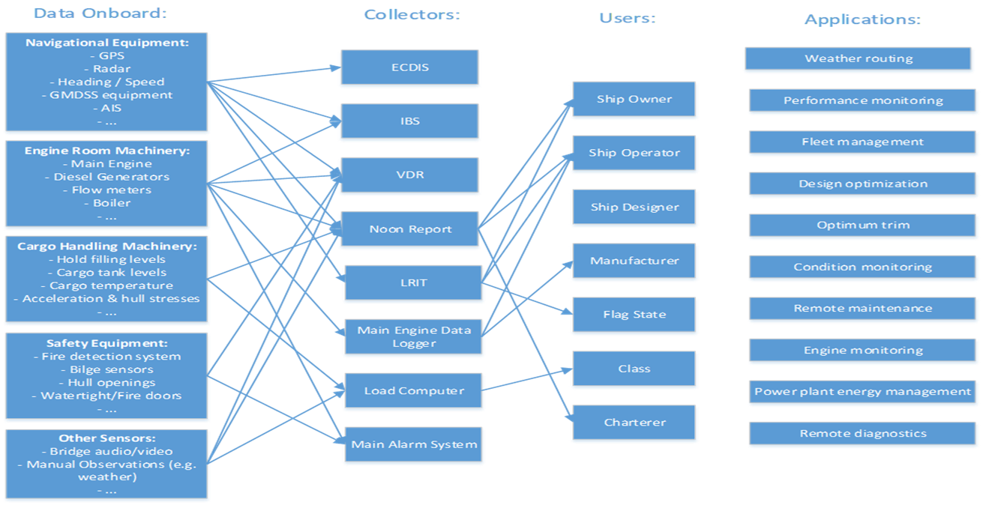
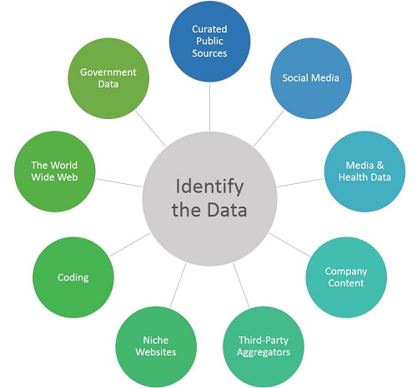
Examples of Big Data Sources: Internal/External, Signal Strength, Data Integration, MetaData Management
http://restaurantsmsmarketing.com/mobile-coupons/

Slide 33

Big Data Creating Sources of Data
(e.g. Dallas Art Museum)
Classical Techniques
Membership in Museum, Monitoring customers.
Big Data Techniques
Search for ways to create new, useful, behavioral data, and to gather open data sources for integration.

Slide 34
What’s Different? How! - Technology

Slide 35
Some Things That Make a Difference Technology
Change | Classical | Big Data | Example
Computing Platforms | Large Symmetric Multiprocessors, expensive | Parallelism using commodity hardware | Cost reduced by x10, Cloud
Software Platforms | RDBMS, Analytic Software, Viz Software | Oriented to massive parallelism, Often Open Source | Map/Reduce, Hadoop, Storm,..
Data Base Systems | RDBMS, Transactional | Often Column Oriented, Availability Oriented | Hbase, MongoDB, Cassandra, ….
Visualization | Static, Aggregate, Dashboards | Interactive, Drill Down | Swift
Streams vs Warehouses | Warehouse: Size: N View: Query Latency: High | Streams: Size: ∞ View: Window Latency: Low | Fraud, High Frequency Trading, Targeted Marketing

Slide 36
Map Reduce Patent
Google granted US Patent 7,650,331, January 2010
System and method for efficient large-scale data processing A large-scale data processing system and method includes one or more application-independent map modules configured to read input data and to apply at least one application-specific map operation to the input data to produce intermediate data values, wherein the map operation is automatically parallelized across multiple processors in the parallel processing environment. A plurality of intermediate data structures are used to store the intermediate data values. One or more application-independent reduce modules are configured to retrieve the intermediate data values and to apply at least one application-specific reduce operation to the intermediate data values to provide output data.

Slide 37
A Challenging Starting Point Data Management
Prof. Michael Stonebraker, MIT
“One Size Fits None - (Everything You Learned in Your DBMS Class is Wrong) ”
http://cs.brown.edu/~ugur/fits_all.pdf

Slide 38
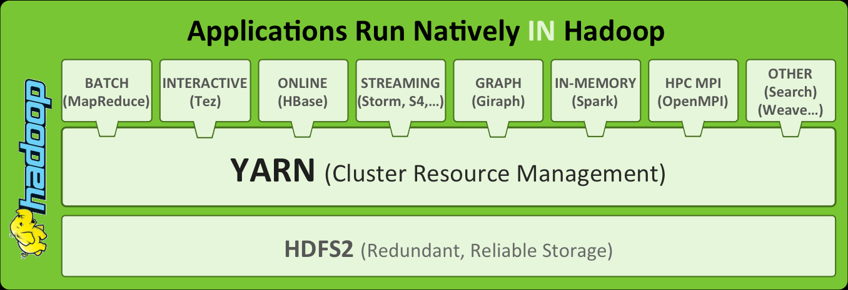
One Approach to Parallelization and Distribution
Map/Reduce – Introduced by Google in 2004
Hadoop – A top tier Apache Project
Apache Hadoop 2 – Open Source http://blog.andreamostosi.name/

Slide 39
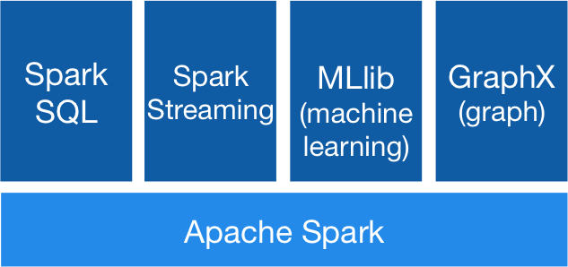
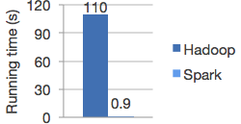
Apache Spark
From Databricks’ Spark Site:
“Run programs up to 100x faster than Hadoop MapReduce in memory, or 10x faster on disk.”

Slide 40
MPP Data Architectures
Sharded MPP
Multiple DBs unified at Application layer
Web Apps: eCommerce, Social
Federated MPP
Multiple DBs unified at Federation layer
DW / Analytics
True MPP
Single DB with distributed storage and SQL execution
DW / Analytics
Client
Client
Client
Client
Client
Client
Application Layer
DB Federation Layer
Overhead eliminated
Meta-data Mgr
SQL Engine
Natively-parallel SQL Engine
Storage Mgr
Scale by adding full instances of DB. Integration across shards done outside DBs.
Custom-built
Scale by adding full instances of DB, one per CPU core. Integration across shards done outside DBs.
Redshift, Azure SQL DW
Scale by adding nodes of multi-threaded execution engines. Integration across nodes done inside engine.
Teradata, XtremeData

Slide 41
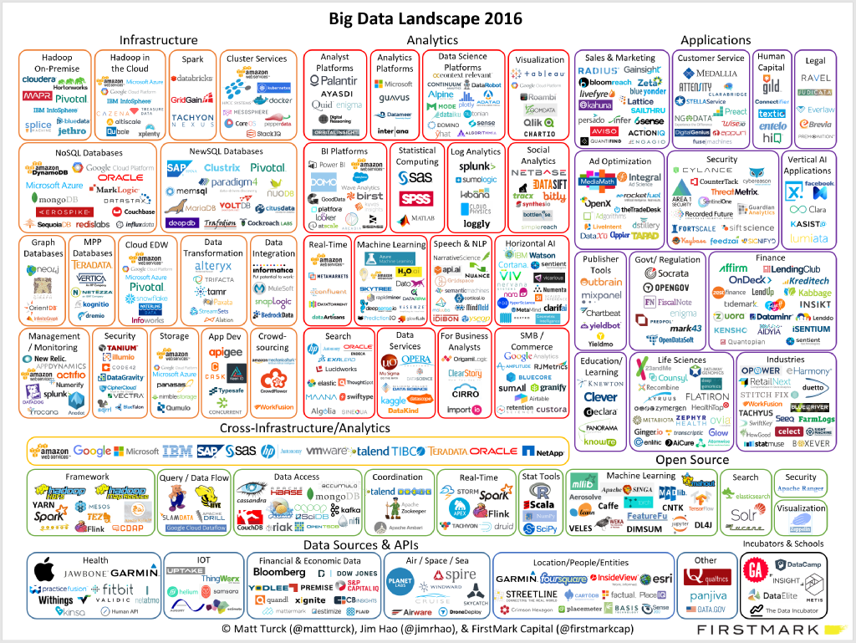
Notes:
Is it real! – first of several

Slide 42
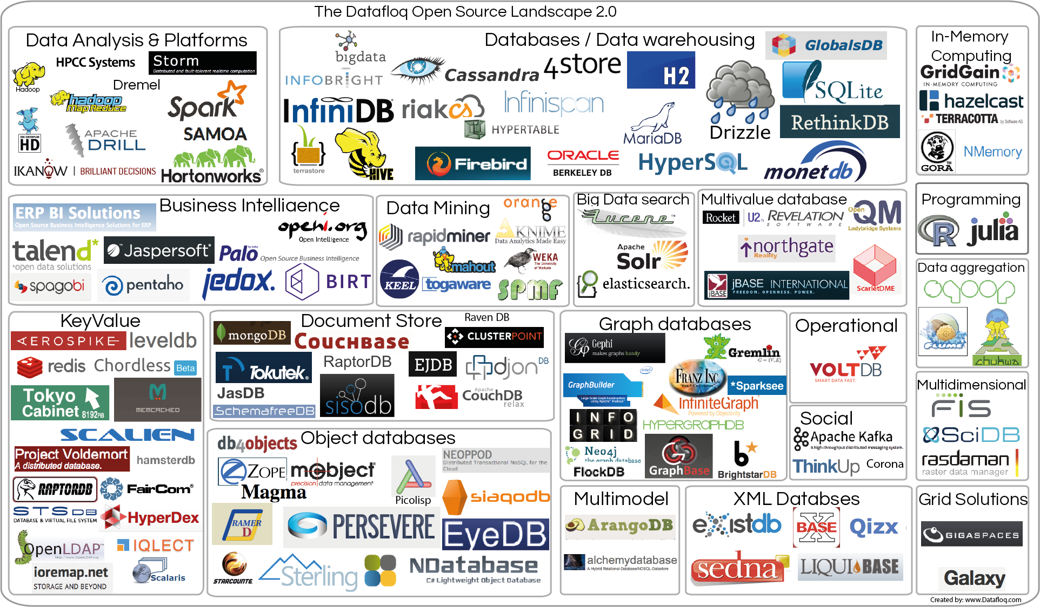
Dataflog Open Source Landscape
https://datafloq.com/big-data-open-source-tools/os-home/

Slide 43
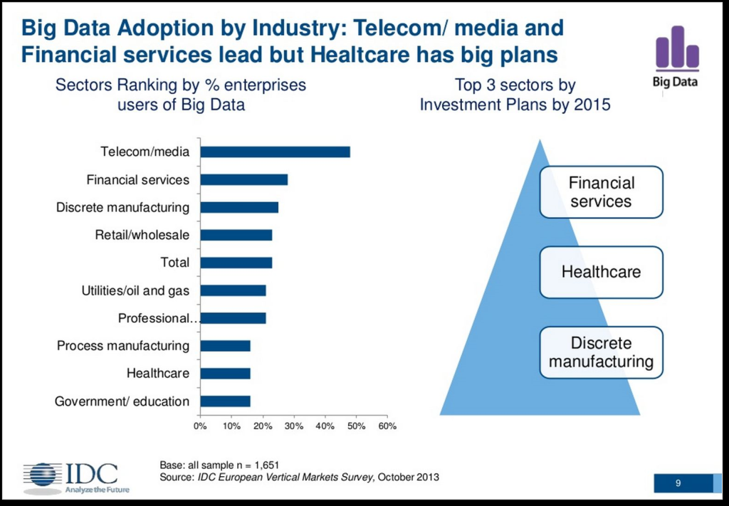
IDC – Adoption by Industry (2013) http://www.bmc.com/blogs/common-challenges-with-big-data-deployments/

Slide 44
Does Scale Matter?

Slide 45
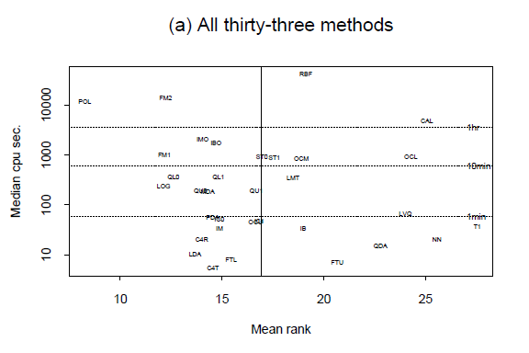

Slide 46
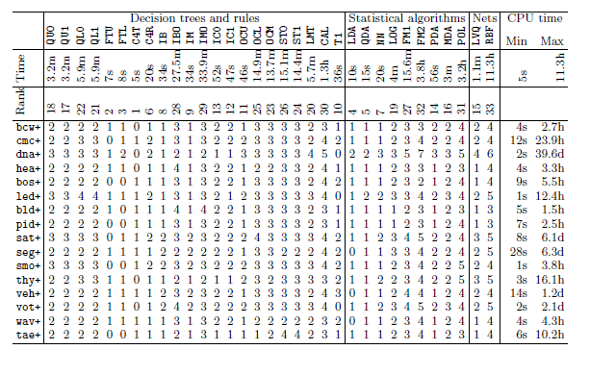

Slide 47
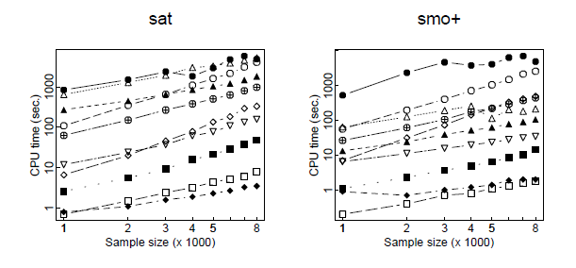
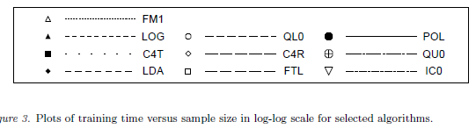

Slide 48
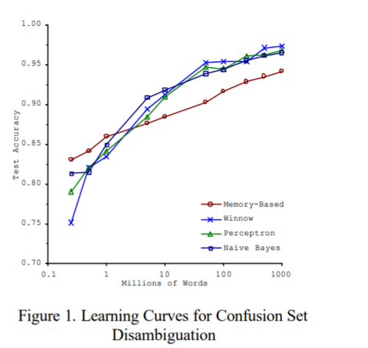
Does Scale Matter (NLP): Scaling to very, very large corpora for natural language disambiguation: Banko and Brill http://www.aclweb.org/anthology/P01-1005

Slide 49
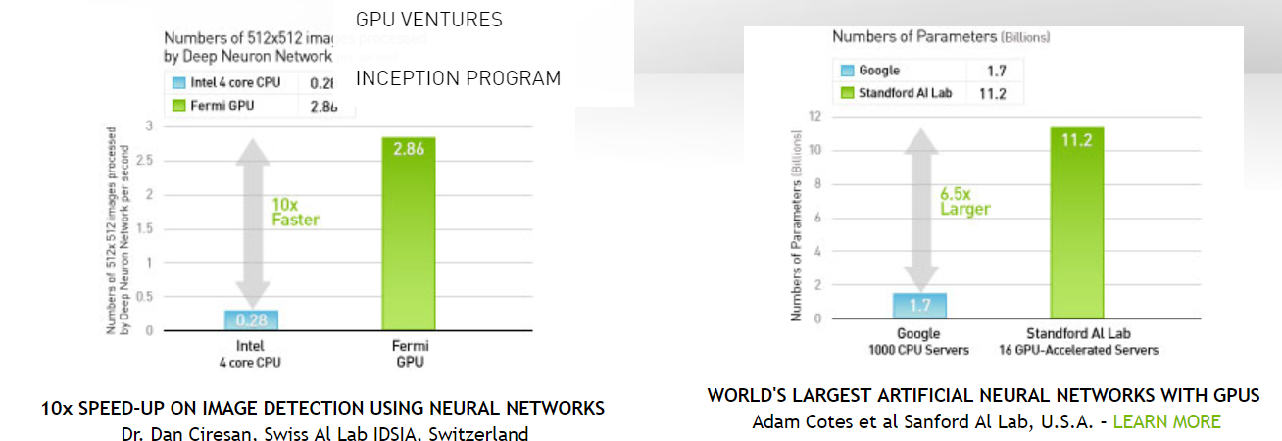
Another View of Scale (GPU) https://www.nvidia.com/object/data-science-analytics-database.html

Slide 50
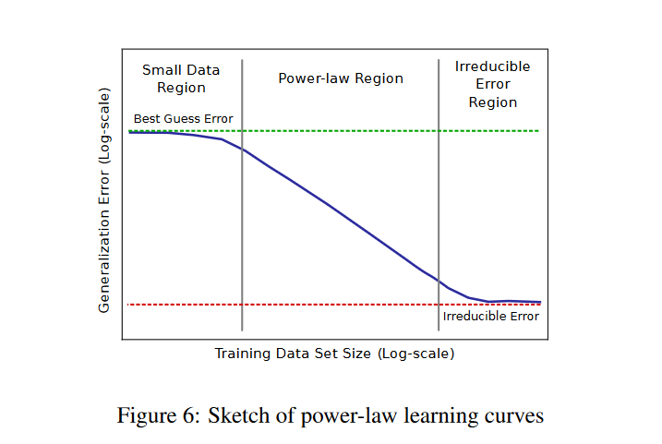
Thinking About Scale Power Law
https://arxiv.org/abs/1712.00409
DEEP LEARNING SCALING IS PREDICTABLE EMPIRICALLY
Joel Hestness, Sharan Narang, Newsha Ardalani, Gregory Diamos, Heewoo Jun,Hassan Kianinejad, Md. Mostofa Ali Patwary, Yang Yang, Yanqi Zhou

Slide 51
Impact of Scale: A Example of Classification Performance Results #3 Study by: Prashanth Ashok Ramkumar, Ram Kharawala, Qing Wei

Slide 52
So What Can One Do About Scale?
Data in Flight:
Shannon’s Law
Compression – lossey or lossless
Parallelization
Distribution – Move the Data Less
Move Processing to Data
Data at Rest:
Compression
Parallelization
Distribution
Storage Structures: e.g. Column Store
Analytics:
Parallelization
Careful Selection of Algorithms or Techniques
Sampling

Slide 53
One Approach to Parallelization and Distribution
Map/Reduce – Introduced by Google in 2004
Hadoop – A top tier Apache Project
Apache Hadoop 2 – Open Source http://blog.andreamostosi.name/

Slide 54
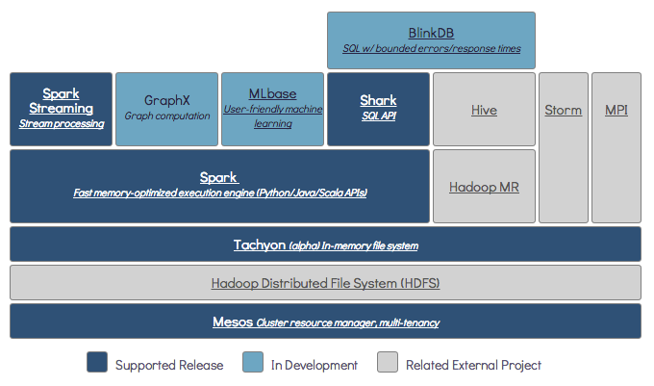
UCB BDAS http://blog.andreamostosi.name/

Slide 55
Back to Basics Definitions

Slide 56

Definitions of Big Data
Data
Warehouse
Standard – Three V’s
Volume
Velocity
Variety
McKinsey Global Institute (2011)
“datasets whose size is beyond the ability of typical database software tools to capture, store, manage, and analyze.”
These Definitions, and others, don’t answer the question:
“What’s really different that matters”?
For example: “How might you use Big Data as it becomes more mainstream”? That is, when “Big Data” becomes “Data”.
Note: Lots of Data is not the same as Big Data
Notes:
Standard Definition from: Doug Laney of Gartner over twelve years ago.
Creating transparency – enabling, for example, the manufacturing sector to integrate “data from R&D, engineering, and manufacturing units to enable concurrent engineering ... (to) significantly cut time to market and improve quality.” This seems much like traditional data warehousing.
Enabling experimentation – “organizations can collect more accurate and detailed performance data ... to instrument processes and then set up controlled experiments … (which) can enable leaders to manage performance at higher levels.” Super-crunching equals analytics + experiments.
Supporting human decision making with automated algorithms – “decision making may never be the same; some organizations are already making better decisions by analyzing entire datasets from customers, employees, or even sensors embedded in products.” The statistical learning world continues to progress.
Innovating new business models – “The emergence of real-time location data has created an entirely new set of location-based services from navigation to pricing property and casualty insurance based on where, and how, people drive their cars.” This affirms Mike Loukides' assertion “that data science enables the creation of data products.”

Slide 57
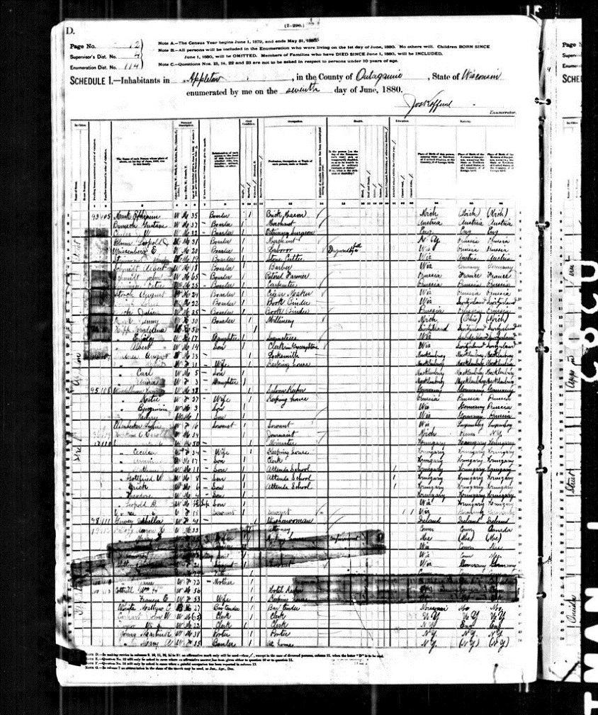
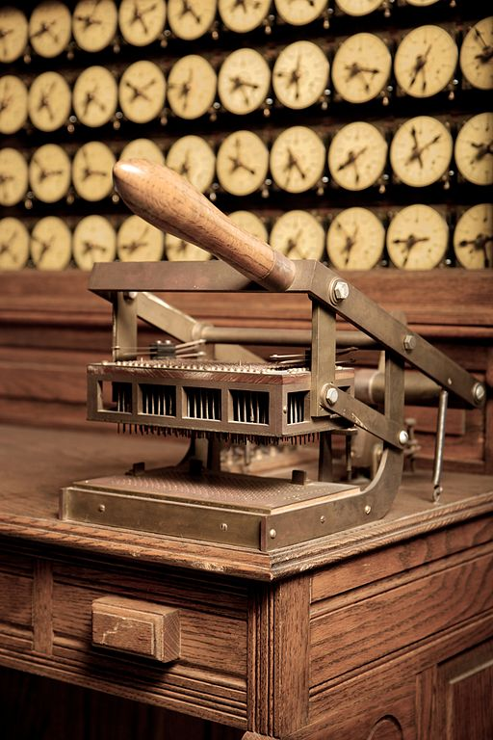
Big Data 1880
Population: 50,189,209
Size: Low Gigabytes
Hollerith Tabulating Machine
Census
Source: http://www.winshuttle.com/big-data-timeline/
Notes:
The 1880 U.S. Census took eight years to tabulate, and it was estimated that the 1890 census would take more than 10 years using the then-available methods. Without any advancement in methodology, tabulation would not have been complete before the 1900 census had to be taken.
The influx of census data led to the invention of the Hollerith tabulating machine (punch cards), which "tamed" the big data and let them complete the job in about a year. It turned Hollerith into an entrepreneur and his company eventually became part of what we know as IBM. Source with special thanks to @ajbowles. http://www.winshuttle.com/big-data-timeline/

Slide 58
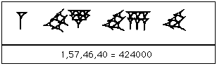
Big Data 2000 BC
Base 60 Positional Arithmetic
1,57,46,40 in Babylonian numerals
Source: http://www-history.mcs.st-and.ac.uk/HistTopics/Babylonian_numerals.html
Notes:
Babylonian’s Used a base 60, right to left number system.

Slide 59
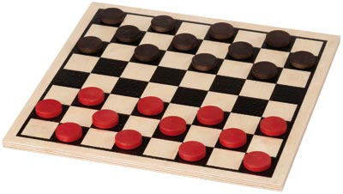
A really big data problem Checkers Solved
From the standard starting position, both players can guarantee a draw.
Search space: ~5 * 10^20, ~500 Exabytes
About 10^15 calculations
Up to 200 desktop computers over ~20 years.
Solved in 2007
Picture Source: http://1.bp.blogspot.com/-pTUtJc-2MPg/UTxjSDhy4gI/AAAAAAAAARs/VFfoDaqyHB4/s1600/checkerBoardMPL.jpg

Slide 60
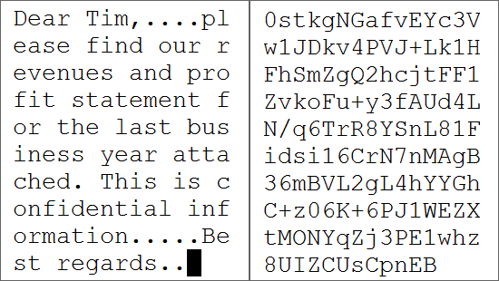
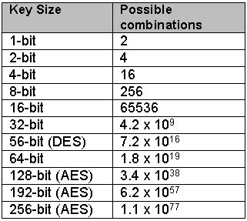
A really big data problem Unsolved - Decryption
Advanced Encryption Standard (NIST)
Block size=128 bits, key length 128,192,256 bits
Symmetric Key Algorithm
Combinations (for 256) is 1.1 * 10^77

Slide 61
Data Lifecycle

Slide 62


Big Data What?, How?, Why?
WHY:
APPLICATIONS
“Valuable capabilities that were formerly too difficult, costly, or simply not possible.”
Why
What
Big Data
How
WHAT:
DATA
VOLUME
VELOCITY
VARIETY
TECHNOLOGY
DISTRIBUTION
D[BS]MGT
MACHINE LEARING ++
Lots of Data is not the same as Big Data
HOW:
GOVERNANCE, ORGANIZATION
PEOPLE
...
Picture Source:
https://www.theguardian.com/science/2014/feb/12/nuclear-fusion-breakthrough-green-energy-source

Slide 63
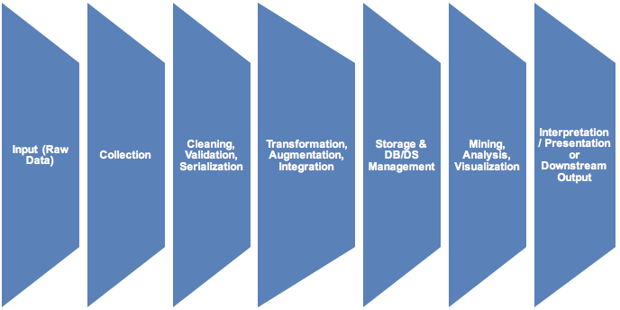
Data Analytics Lifecycle

Slide 64
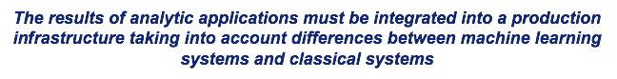
Data Analytics Production Lifecycle
Data Lifecycle I (Basic)
Collection
Cleaning, Validation, Serialization
Transformation, Augmentation, Integration
Storage & DB/DS Management
Mining, Analysis, Visualization
Interpretation/Presentation or Downstream Output
Input Data
Deployment
Operations
Maintenance
Automated Change Control
Automated Data Feed Monitor
Resource and Capacity Management
Incubation: Sandbox to Deployment to Operations
Upgrade Strategy
Dashboards and Logs
Configuration Management
Feature Set Management
Version, Configuration, Build
Platform Integration
Testing and QA
Standard Testing Technology – e.g. Code Review, etc.
Test Data Structure, Version, Drift Control
Metadata and Semantics Documentation
Testing Environments: Unit, Integration, System, Load
Concurrency, etc.
Non-Functional Requirements
Performance
APIs
Reliability: MTTF, MTTR
Security, Privacy
Notes:
Sails Deck slide 113

Slide 65
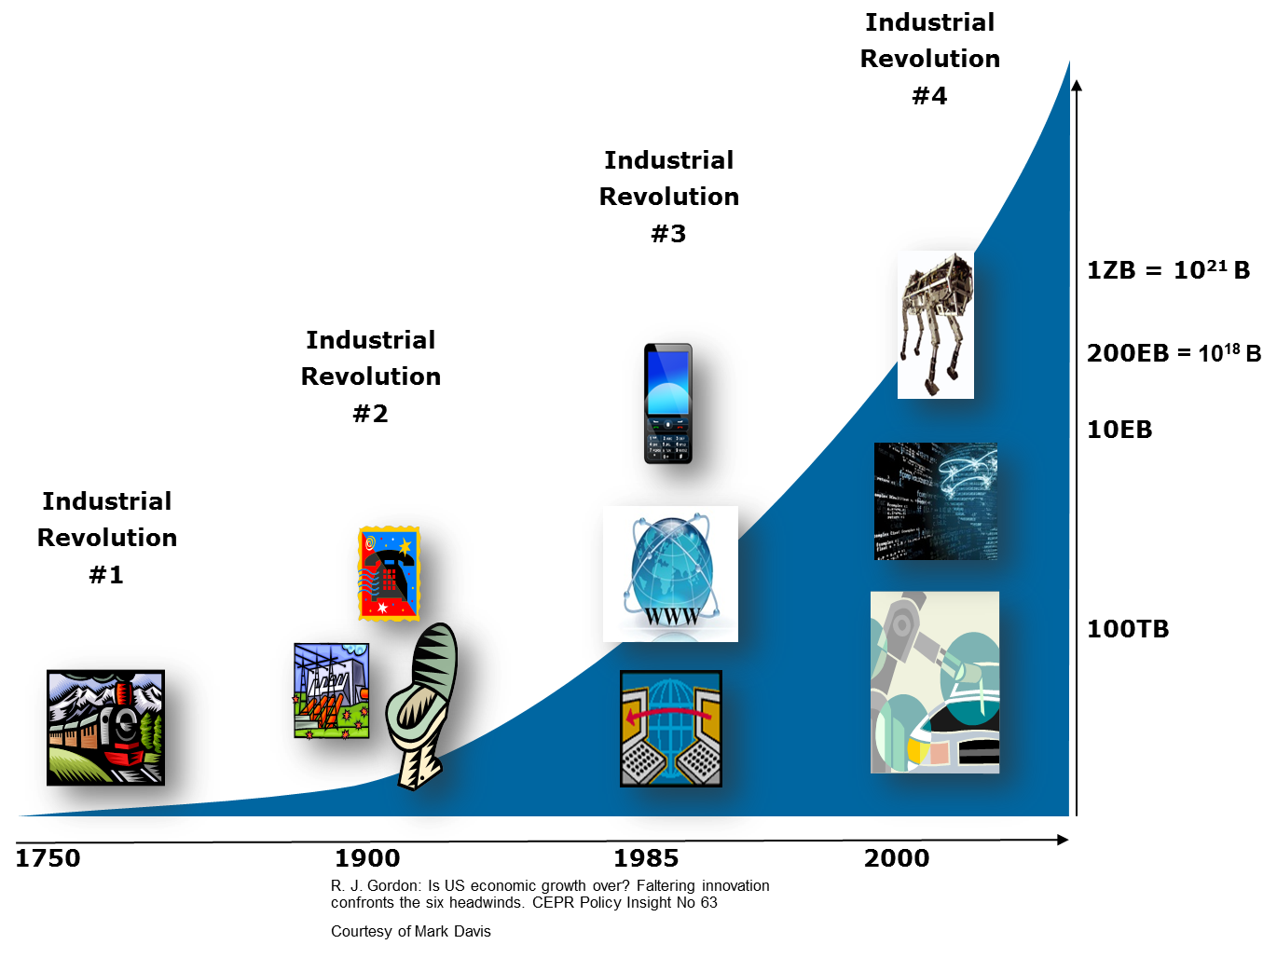
Big Data Movement
By 2020, all digital data created, replicated, consumed, in a year: 40 ZB
(40 ZB: equivalent to 40,000,000,000,000 GB)
(IDC, Dec 2012)

Slide 66








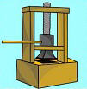
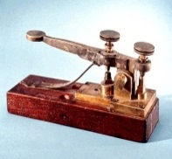
Information Revolutions
IR5
5G/IoT/SDN
IR4
Mobility/3G-4G
IR3
WWW/Crowd
4G
3G
IR1
Printing Press
IR2
Telephone/Telegraph

Slide 67
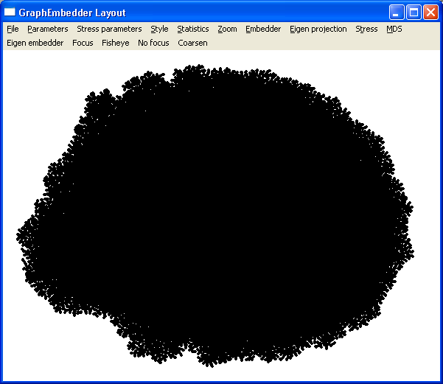
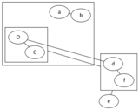
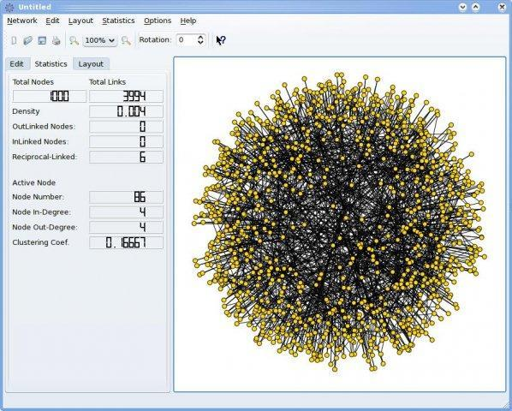
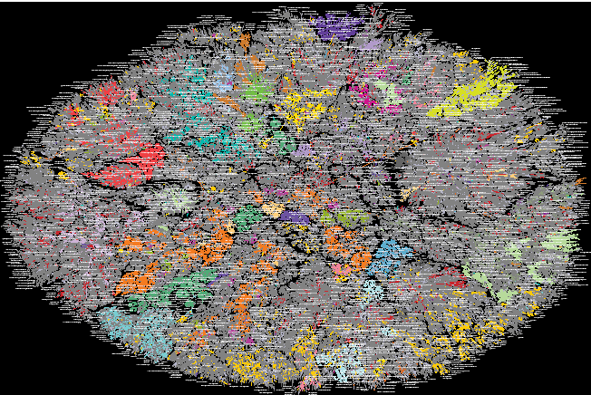
What Does “Big” Look Like?
7
1,000
Image Source Page: http://www.graphviz.org/About.php
Image Source Page: http://sourceforge.net/projects/socnetv/
~C(10^5)

Slide 68
Getting a feel for the technology

Slide 69
Word Counting An Analogy
Assume we have 100,000 pages of text, and we want to see how many times a word “foo” appears in them. Assume also we have 100 people and desks.
Let’s look at 2 approaches
Classical:
Select the fastest reader
Provide him/her with the desk where the 100,000 pages are stored, and lots of equipment support.
HDFS (Hadoop File System):
Distribute the pages to each desk roughly uniformly.
Keep track of where page sets (1000 pages) are stored.
Provide reasonable, but inexpensive equipment.

Slide 70
Word Counting An Analogy
Assume we have 100,000 pages of text, and we want to see how many times a word “foo” appears in them. Assume also we have 100 people and desks.
Let’s look at 2 approaches
Classical:
Select the fastest reader
Provide him/her with the desk where the 100,000 pages are stored, and lots of equipment support.
Ask the fastest reader to count the occurences of “foo”.
HDFS (Hadoop File System):
Distribute the pages to each desk roughly uniformly.
Keep track of where page sets (1000 pages) are stored.
Provide reasonable, but inexpensive equipment.
Ask each person to count occurences of “foo” in his/her desk.
Add up the results for a total.

Slide 71
Word Counting An Analogy
Assume we have 100,000 pages of text, and we want to see how many times a word “foo” appears in them. Assume also we have 100 people and desks.
Let’s look at 2 approaches
Classical:
Select the fastest reader
Provide him/her with the desk where the 100,000 pages are stored, and lots of equipment support.
Ask the fastest reader to count the occurences of “foo”.
HDFS (Hadoop File System):
Distribute the pages to each desk roughly uniformly.
Keep track of where page sets (1000 pages) are stored.
Provide reasonable, but inexpensive equipment.
Ask each person to count occurences of “foo” in his/her desk.
Add up the results for a total.

Slide 72
Word Counting An Analogy - Software
Assume we have 100,000 pages of text, and we want to see how many times a word “foo” appears in them. Assume also we have 100 people and desks.
Let’s look at the 2 approaches
Classical:
A single program, probably in Java, Python, or C++ but perhaps in a special purpose language.
Tokenize (i.e. separate into words).
For each token, if token = “foo” add 1 to counter.
At end, output value of counter.
HDFS (Hadoop File System):
Two types of programs, a Mapper and a Reducer. Probably written in Java, Python, or a similar language. (or use SPARK, et. al.)
Same mapper runs on each computer, and outputs a key/value pair if it sees a “foo”. If it doesn’t, no output. (Could also do count).
Output of all Mappers is input to Reducers, also written in Java, Python, etc.
Reducer adds up all the “values” output from Mappers, and outputs total Value.

Slide 73
Word Counting An Analogy
Assume we have 100,000 pages of text, and we want to see how many times a word “foo” appears in them. Assume also we have 100 people and desks.
Let’s look at 2 approaches
Results:
With some skill on all parties, the results will be the same.

Slide 74
Word Counting Counting the occurences of “foo”
Assume we have 100,000 pages of text, and we want to see if a word “foo” appears in any of them. Assume also we have 100 people and desks.
A short, incomplete, and biased by this type of problem, list:
Issue | SMP | HDFS/GFS/etc.
Capital Cost | High | Perhaps factor of 10 lower
Elapsed Time | Variable | Lower but batch
Programming | Java, Python, C++, etc | Map/Reduce, SPARK, et. al.
Flexibility | Nearly any problem | Parallelizable problems
Cloud | Sometimes | Usual environment
Maturity | Very Mature | Maturing
Operational Cost | High | Generally lower

Slide 75
Word Counting A slightly different problem
Assume we have 100,000 pages of text. Assume also we have 100 people and desks.
But now assume that each line has an author, and the goal is to find all authors who have written both “foo” and “bar”. Note: this could be “which customer at a store buys two particular items together” – think Amazon.
Classical:
Read entire file keeping track of each author as they use one or the other of terms. Perhaps a hash table.
Output author every time a pair is discovered.
HDFS (Hadoop File System):
Each person reads their section and outputs: <author, foo> or <author, bar> if found. (Why different from above?)
Second set of people collects all pairs for a given author and outputs author if one of each term is found.

Slide 76
Word Counting A slightly different problem
Assume we have 100,000 lines of customer records. Assume also we have 100 people and desks.
:But now assume that each line has a customer ID and a product/products purchased. : can we find which customers purchased the same set of products in the last month?.
Classical:
Discussion - hash table, linked list, array, …
HDFS (Hadoop File System):
Discussion – why is this different?

Slide 77
Word Counting Counting the number of “foo”s and “bar”s
That doesn’t seem too bad, but what if we want to see if there are more “foo”’s or more “bars”?
Programming:
Classical:
A single program, probably in Java, Python, or C++ but perhaps in a special purpose language.
Tokenize (i.e. separate into words).
For each token, if token = “foo” add 1 to counter1, if “bar” add 1 to counter2.
At end, output values of counters 1 and 2, and choose the larger.

Slide 78
Word Counting Counting the number of “foo”s and “bar”s
That still doesn’t seem too bad, but what if we can to see if there are more “foo”’s or more “bar”s in a parallel, shared nothing system?
Programming:
HDFS (Hadoop File System):
Two types of programs, a Mapper and a Reducer. Probably written in Java, Python, or a similar language.
Same Mapper runs on each computer, and outputs a key/value pair if it sees a “foo” with Key=“foo” and Value=1; If it sees “bar”, Key=“bar” and Value=1. (or mapper could count the “foo”s and “bar”s it sees and output.
Output of all Mappers is sorted by Key and input to Reducers with all pairs with the same Key going to the same Reducer. WHY?
An output program receives the results of the Reducers, chooses the larger, and outputs the results.

Slide 79
Big Data What?, How?, Why?
WHY:
APPLICATIONS
“Valuable capabilities that were formerly too difficult, costly, or simply not possible.”
Why
What
Big Data
How
WHAT:
DATA
VOLUME
VELOCITY
VARIETY
TECHNOLOGY
DISTRIBUTION
D[BS]MGT
MACHINE LEARING ++
Lots of Data is not the same as Big Data
HOW:
GOVERNANCE, ORGANIZATION
PEOPLE
...
Picture Source:
https://www.theguardian.com/science/2014/feb/12/nuclear-fusion-breakthrough-green-energy-source

